Slide 1
Chapter 7 Advanced sorting algorithms

Slide 2
Merge Sort Algorithm
Merge Sort is a popular and efficient sorting algorithm known for its simplicity and effectiveness.
It follows the divide-and-conquer paradigm, breaking down a problem into smaller sub-problems, solving them, and then combining the solutions to the sub-problems to obtain the final result.
A divide and conquer algorithm is a strategy of solving a large problem by
Divide: breaking the problem into smaller sub-problems
Conquer: solving the sub-problems, and
Combine: combining them to get the desired output.

Slide 3
Cont.
Many well-known algorithms follow the divide-and-conquer paradigm, including:
Merge Sort: Divides the array into two halves, sorts each half, and then merges the sorted halves.
Quick Sort: Divides the array into two partitions, recursively sorts each partition, and combines them in place.
Binary Search: Divides the search interval in half at each step, narrowing down the possible locations of the target.
Strassen's Algorithm for Matrix Multiplication: Divides matrices into smaller sub-matrices, performs recursive multiplications, and combines the results.
The divide-and-conquer approach is powerful because it often leads to algorithms with efficient time complexities.
However, it may require additional space in some cases, and the efficiency gains might be offset by overhead from recursion.

Slide 4
Cont.
The key idea behind Merge Sort is to repeatedly divide the unsorted list into two halves until each sub-list contains only one element.
Afterward, it merges these sub-lists in a way that produces a sorted result.
It ensures stability, meaning that the relative order of equal elements remains unchanged after sorting.
Additionally, Merge Sort has a time complexity of O(n log n), making it suitable for large datasets.

Slide 5
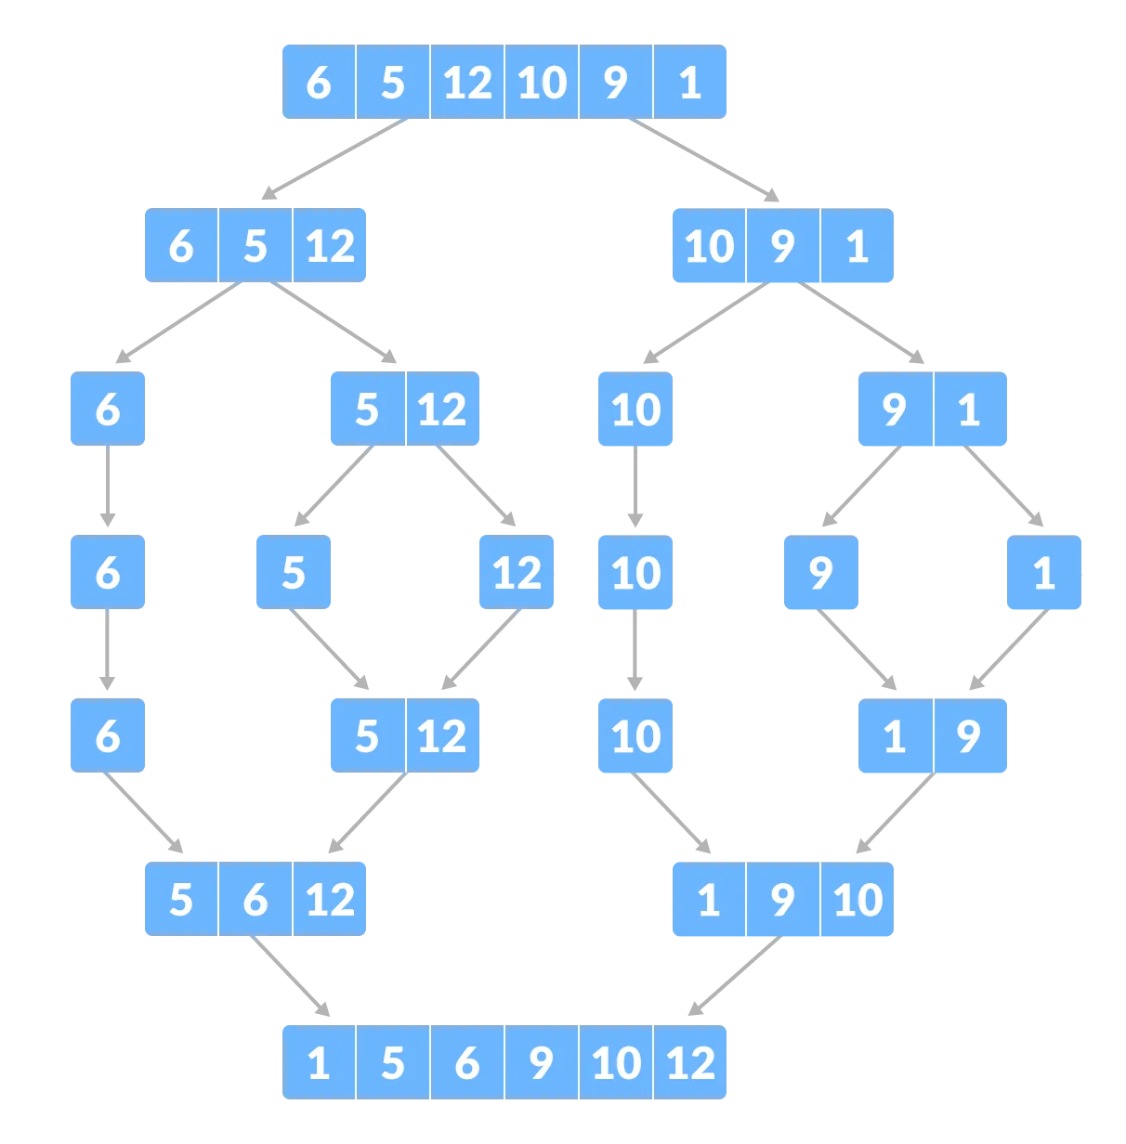
Cont.
Example

Slide 6
Cont.
While Merge Sort exhibits consistent and reliable performance, it does require additional space for the merging process.
This is because it typically uses an auxiliary array to store the merged results before updating the original array.
Despite this drawback, Merge Sort's simplicity, stability, and efficient time complexity make it a popular choice for various applications, especially when a stable and predictable sorting algorithm is needed.

Slide 7
Quick Sort
The quicksort algorithm is the most widely used algorithm and the most efficient sorting algorithm.
It works on the divide and conquer approach, i.e., the array is divided into sub arrays, and when these sub arrays are sorted, they are combined to form a complete sorted array.
An array is divided into sub arrays by selecting a pivot element (element selected from the array).

Slide 8
Cont.
While dividing the array, the pivot element should be positioned in such a way that elements less than pivot are kept on the left side and elements greater than pivot are on the right side of the pivot.
The efficiency of QuickSort lies in its partitioning strategy.
Choosing a good pivot significantly influences the algorithm's performance.
In the typical implementation, the pivot is chosen as the last element of the sub-array.

Slide 9
Cont.
QuickSort has an average-case time complexity of O(n log n), making it one of the fastest sorting algorithms in practice.
However, its worst-case time complexity is O(n^2), which occurs when the pivot selection consistently results in unbalanced partitions.
To mitigate this, variations like randomized QuickSort use random pivot selection to achieve better average-case performance.

Slide 10
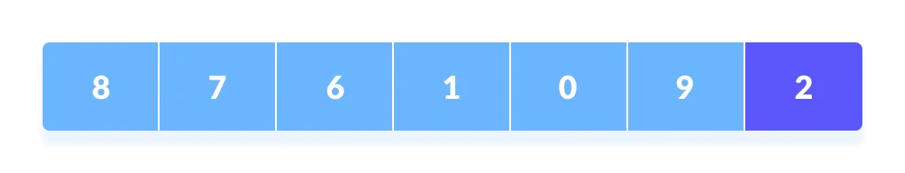
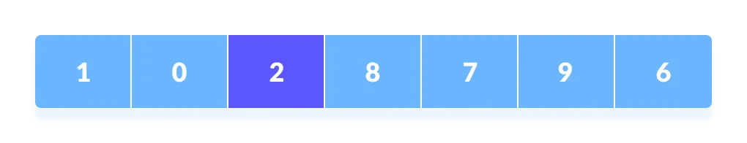
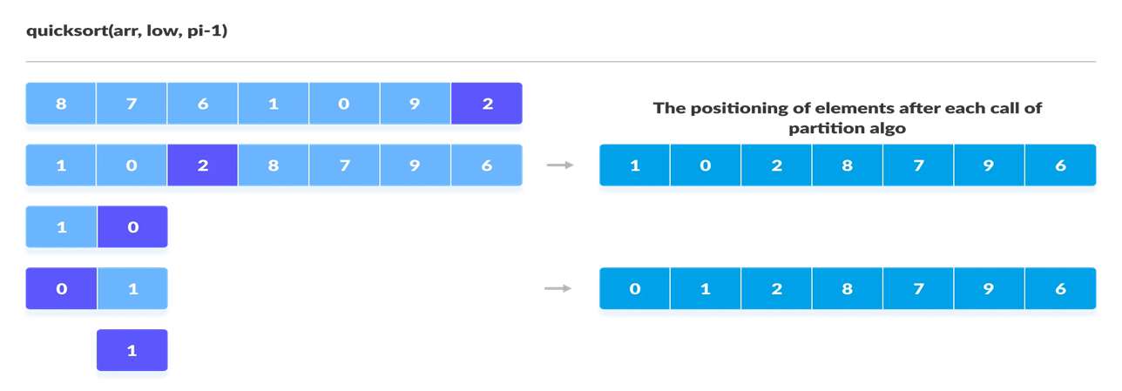
Example

Slide 11
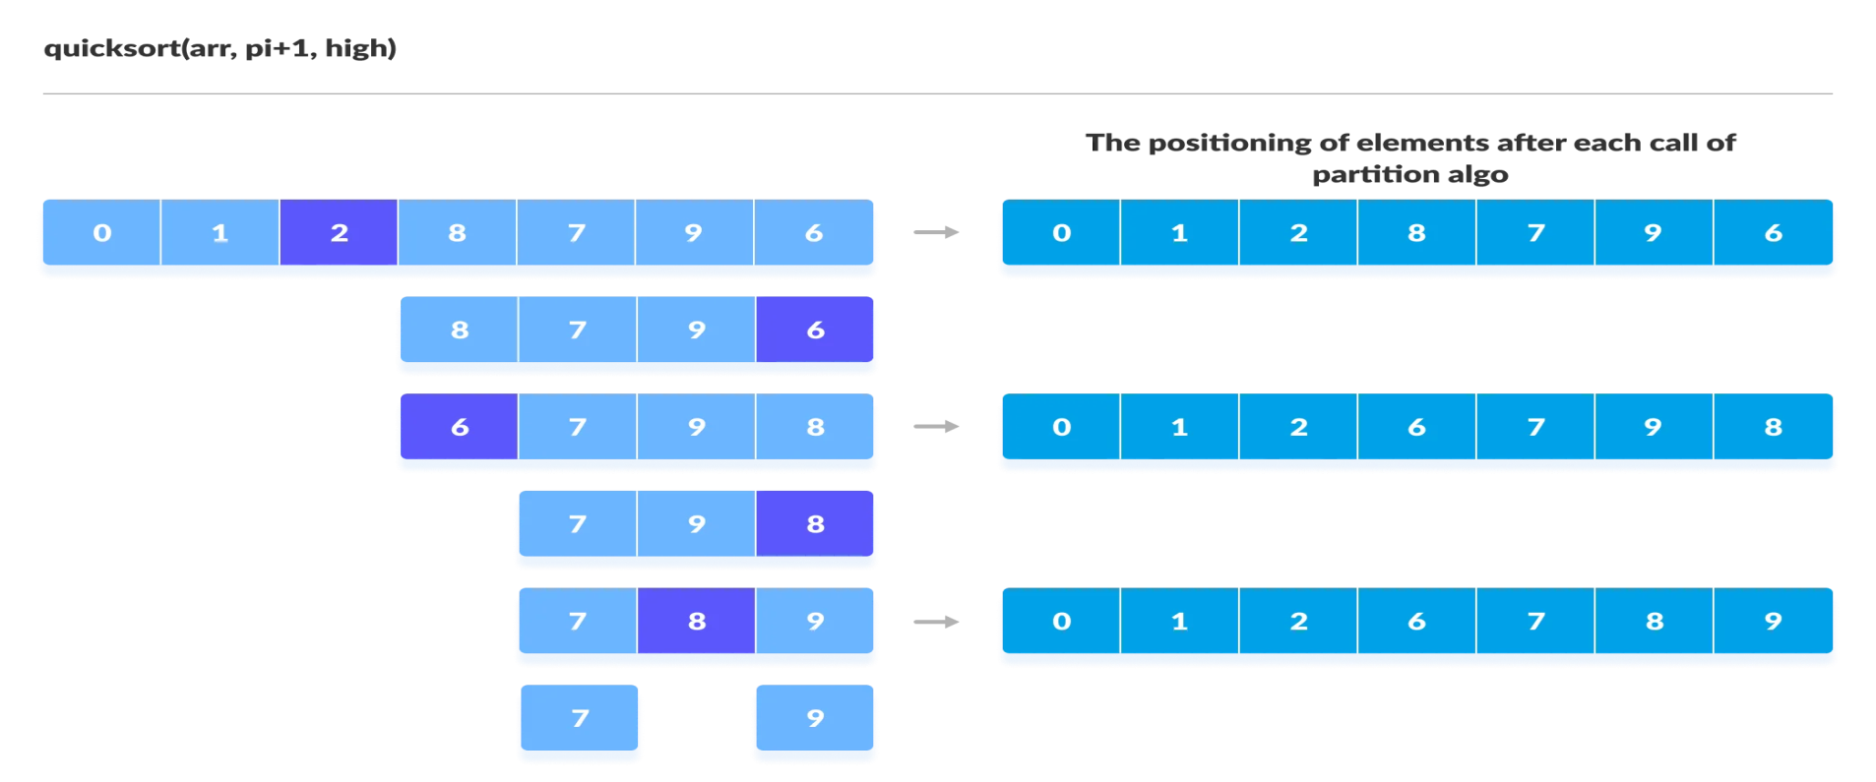
Cont.

Slide 12
Heap sort
Heap sort is a comparison-based sorting technique based on Binary Heap data structure.
It is similar to selection sort where we first find the minimum element and place the minimum element at the beginning.
We repeat the same process for the remaining elements.
Heap sort works by visualizing the elements of the array as a special kind of complete binary tree called a heap.

Slide 13
Cont.
Heapify (Build Max-Heap or Min-Heap): The first step involves building a binary heap from the input array.
A binary heap is a complete binary tree where each node satisfies the heap property (either max-heap or min-heap).
In the case of Heap Sort, the algorithm typically builds a max-heap.
Sorting: Once the max-heap is constructed, the largest element (at the root) is swapped with the last element in the array.
After this swap, the algorithm reduces the heap size by one and then applies a heapify operation to restore the max-heap property.
These steps are repeated until the entire array is sorted.

Slide 14
Cont.
The efficiency of Heap Sort is notable for its optimal time complexity of O(n log n) in the worst, average, and best cases.
This makes it more predictable compared to some other sorting algorithms.
However, it has a larger constant factor hidden in the O(n log n) notation, making it less efficient in practice for small datasets compared to quicksort or mergesort.
Heap Sort is an in-place sorting algorithm, meaning it doesn't require additional memory space for temporary data structures.
It is also not sensitive to the initial order of the elements in the input array.

Slide 15
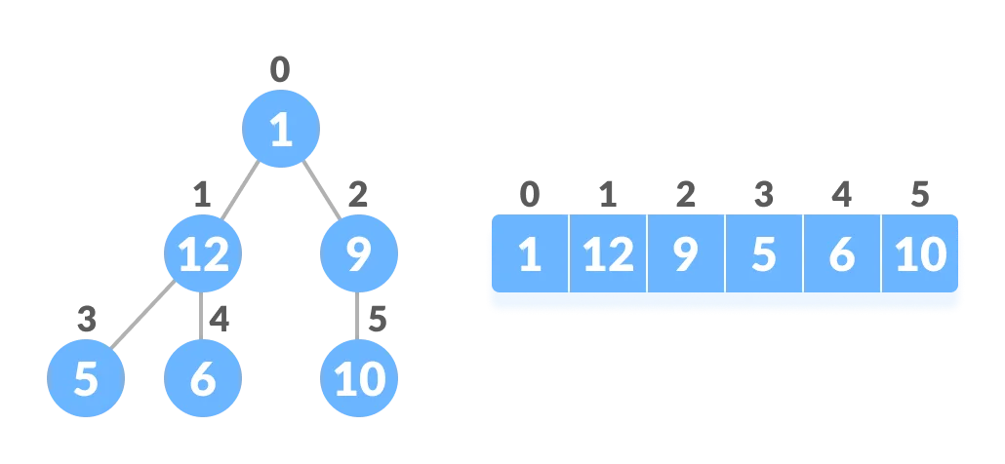
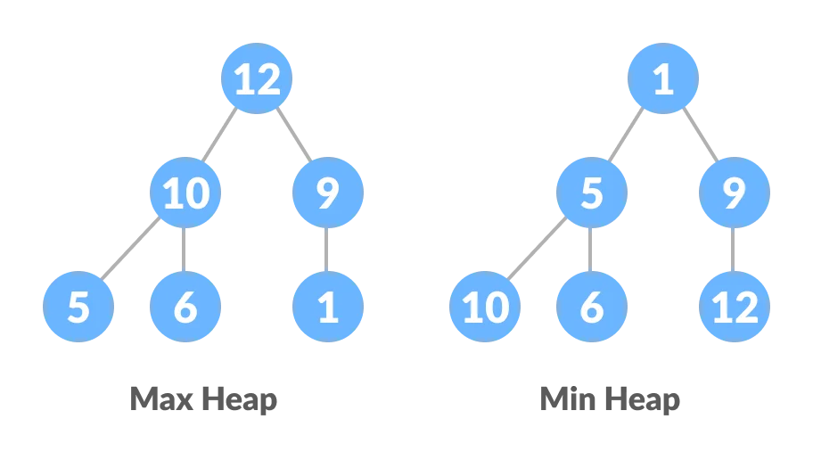
Example

Slide 16
Cont.
Heap Sort is a robust and efficient sorting algorithm that relies on the heap data structure.
Its consistent performance and lack of sensitivity to input order make it suitable for various applications where a reliable and predictable sorting algorithm is needed.

Slide 17
Shell sort
Shell Sort, also known as diminishing increment sort, is an efficient and adaptive sorting algorithm.
It improves upon the insertion sort algorithm by sorting distant elements first and progressively reducing the gap between elements to be compared and swapped.
In insertion sort, we move elements only one position ahead.
The idea of Shell Sort is to allow the exchange of far items.

Slide 18
Cont.
In Shell sort, we make the array h-sorted for a large value of h.
We keep reducing the value of h until it becomes 1.
An array is said to be h-sorted if all sub lists of every h’th element are sorted.
Shell Sort is adaptive, meaning its performance adapts to the characteristics of the input data. It tends to perform well even on partially sorted datasets.
However, the efficiency of Shell Sort depends on the choice of the increment sequence, and the optimal sequence may vary depending on the application.

Slide 19
Cont.
While not as widely used as some other sorting algorithms like quicksort or mergesort, Shell Sort remains a practical choice for situations where the input data might be partially sorted, and its adaptability can be advantageous.
Its time complexity is generally better than quadratic algorithms like insertion sort, making it a reasonable alternative for certain scenarios.

Slide 20
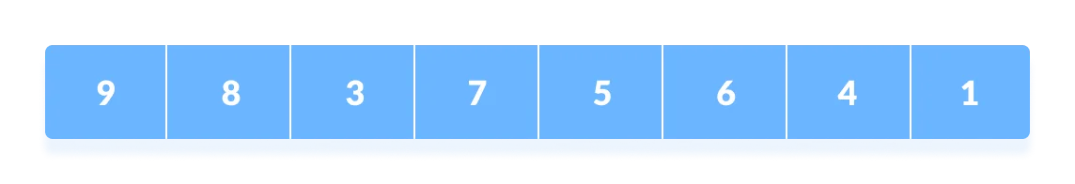
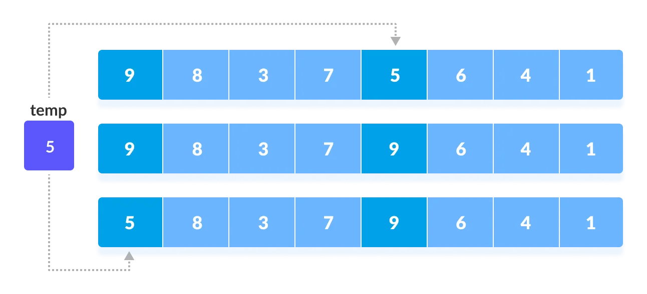
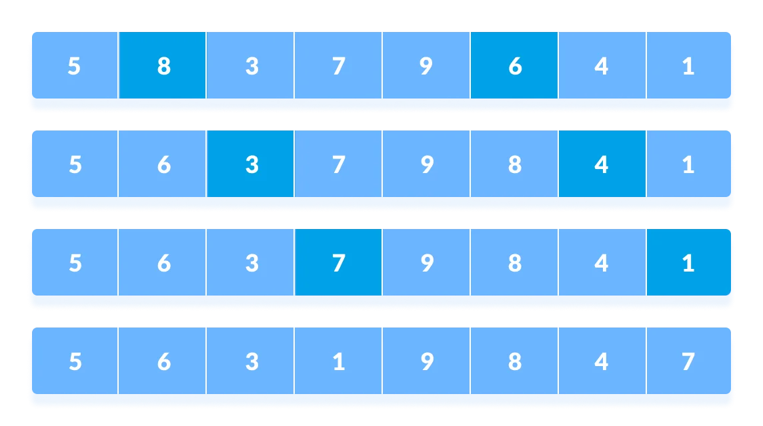
Cont.

Slide 21
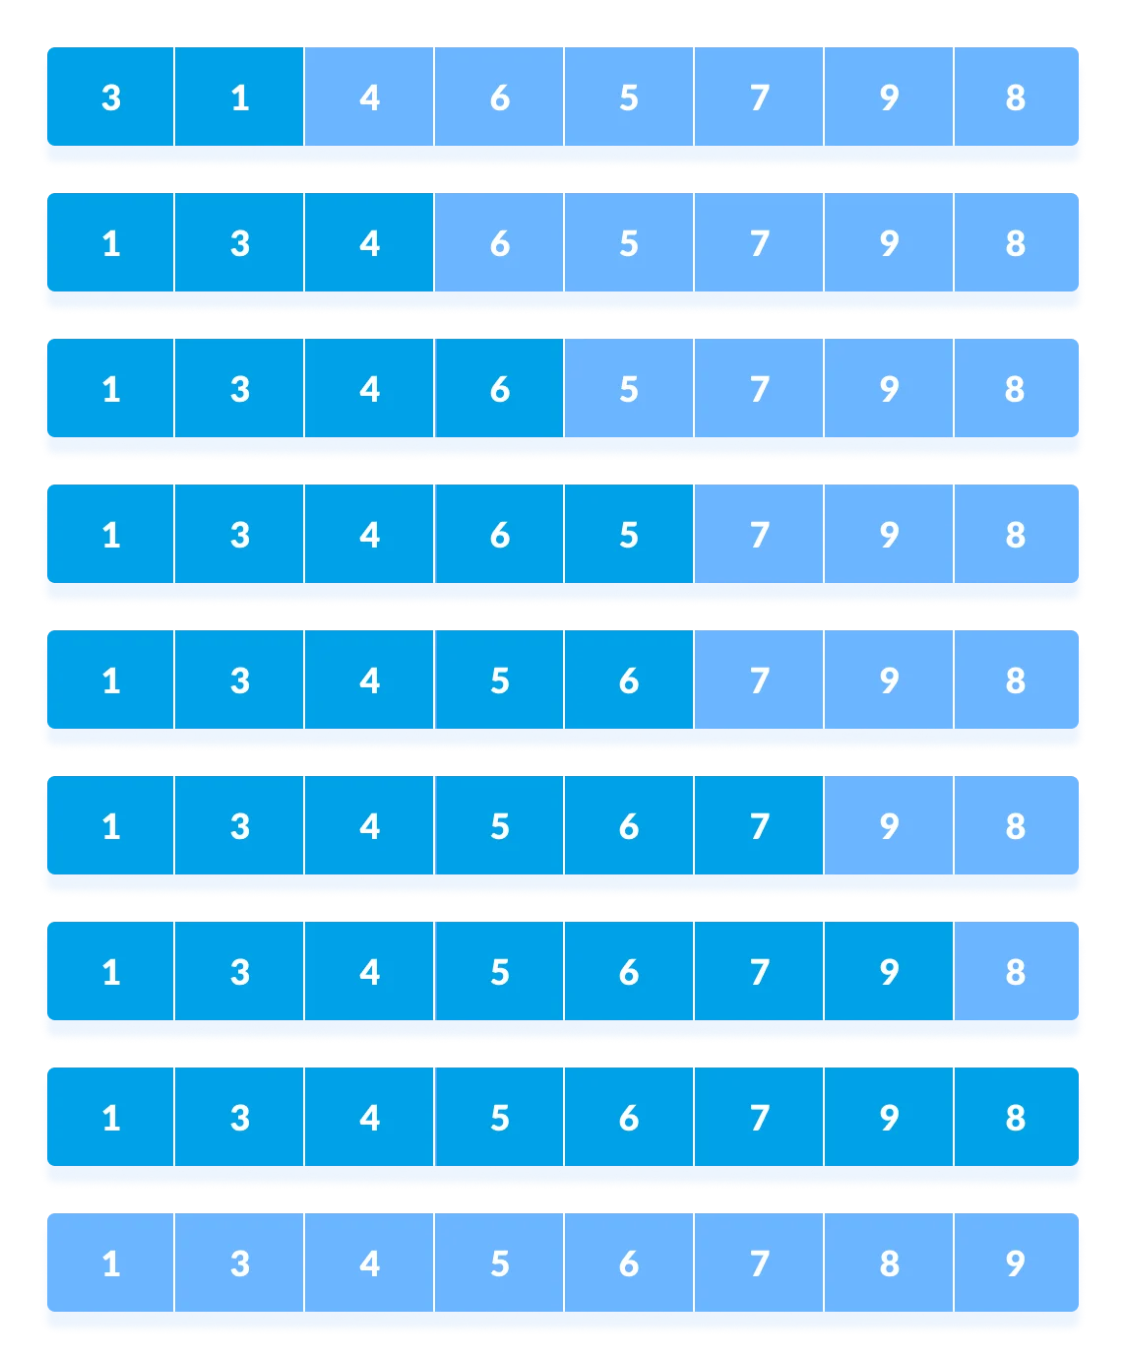
Cont.

Slide 22
Complexity Analysis of Algorithms
A technique to characterize the execution time of an algorithm independently from the machine, the language and the compiler.
Useful for:
evaluating the variations of execution time with regard to the input data
comparing algorithms

Slide 23
Reading assignment
Complexity Analysis of Algorithms
What is runtime ?
What is Big O notation ?

Slide 24
End

